Slide 1
PAL Session 3
Discrete Mathematics - Problem Sheet 1

Slide 2
Today’s Plan
We’ll quickly go over questions similar to the ones on your problem sheet:
Proving whether a formula is a tautology.
Dealing with statements with quantifiers.
The union and subtraction between sets.
Determining the cardinality of a set.
Then the rest of the time you can work on your problem sheet.

Slide 3
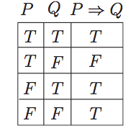
State whether a Boolean formula is a Tautology.
Easiest way, draw a truth table!
P = X ∨ Y , Q = ¬X . Is P → Q a tautology, identically false, or neither?
X | Y | X ∨ Y | ¬X | (X ∨ Y ) →¬X
0 | 0 | 0 | 1 | 1
1 | 0 | 1 | 0 | 0
0 | 1 | 1 | 1 | 1
1 | 1 | 1 | 0 | 0

Slide 4
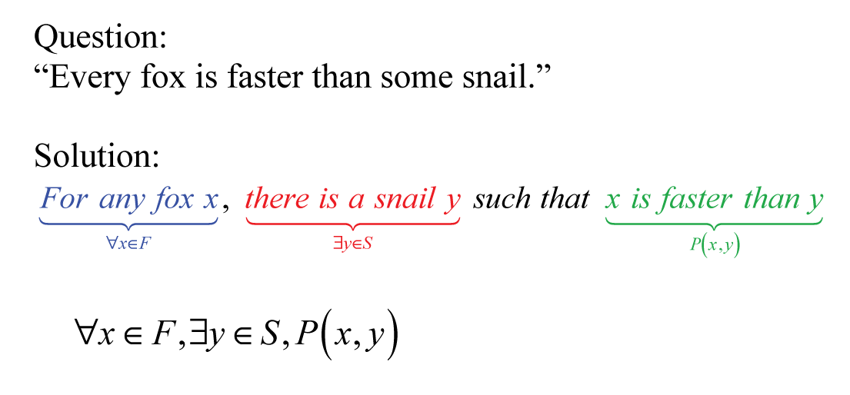
Quantifiers
Universal Quantifier ∀x - For All x
Existential Quantifier ∃x - There is an x.

Slide 5
Proving Statements with Quantifiers
∃x ∈ Z ∃y ∈ Z (…)
There is an x and y that satisfies this equation.
To prove this is true, you just need to give an example proving it.
To prove its false, perhaps easier to prove its negation is true.
∃x ∈ Z ∃y ∈ Z (x + y =2)
When x = 1, and y = 1.

Slide 6
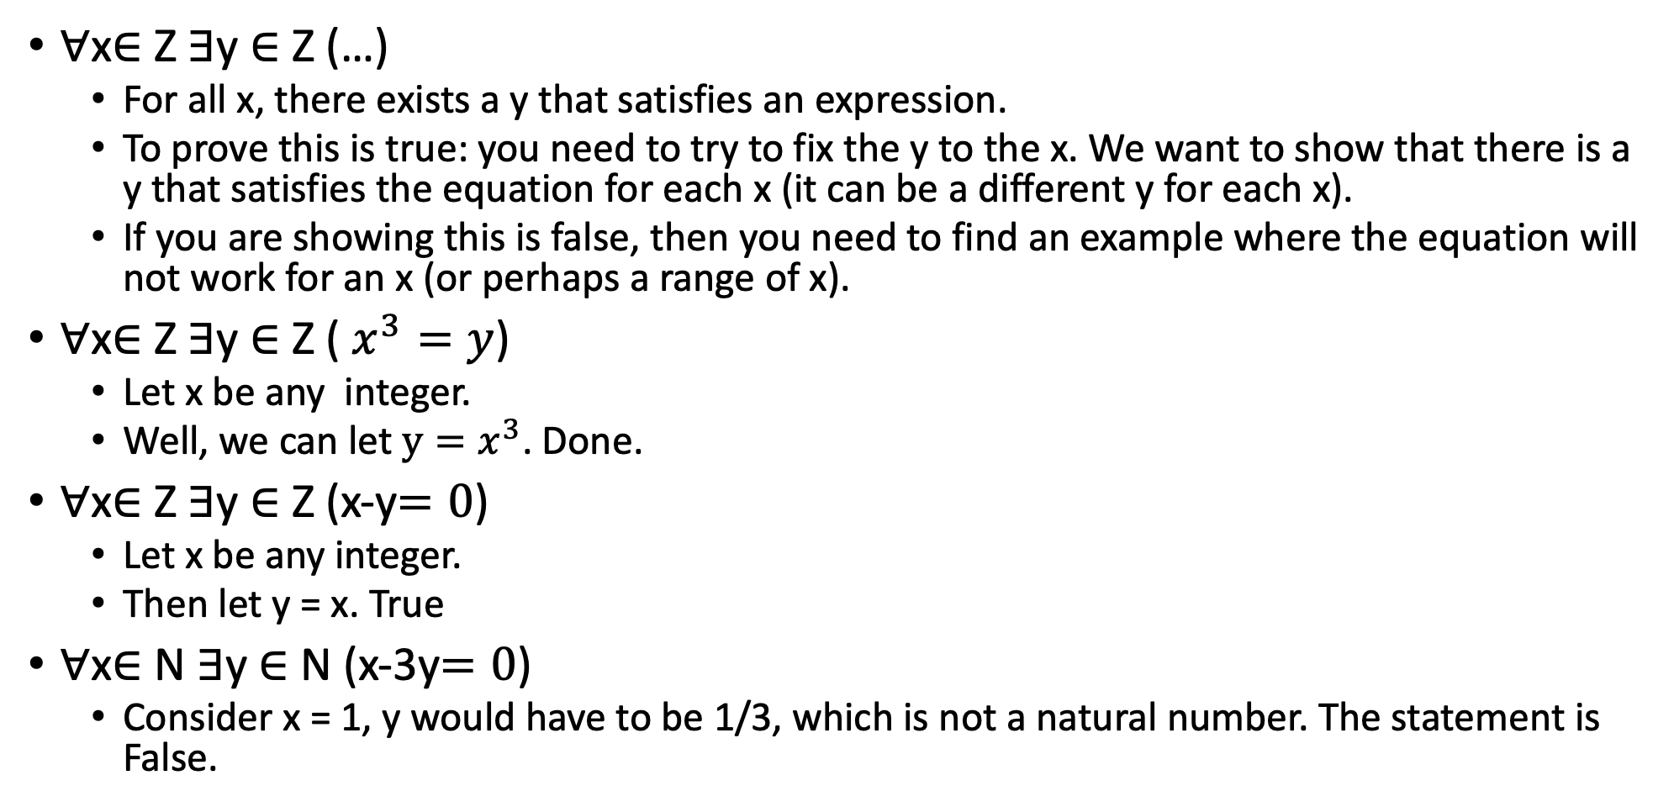
Proving Statements with Quantifiers
∀x∈ Z ∃y ∈ Z (…)
For all x, there exists a y that satisfies an expression.
To prove this is true: you need to try to fix the y to the x. We want to show that there is a y that satisfies the equation for each x (it can be a different y for each x).
If you are showing this is false, then you need to find an example where the equation will not work for an x (or perhaps a range of x).
∀x∈ Z ∃y ∈ Z ( $x^{3}=y$)
Let x be any integer.
Well, we can let $y=x^{3}$. Done.
∀x∈ Z ∃y ∈ Z (x-y$=0$)
Let x be any integer.
Then let y = x. True
∀x∈ N ∃y ∈ N (x-3y$=0$)
Consider x = 1, y would have to be 1/3, which is not a natural number. The statement is False.

Slide 7
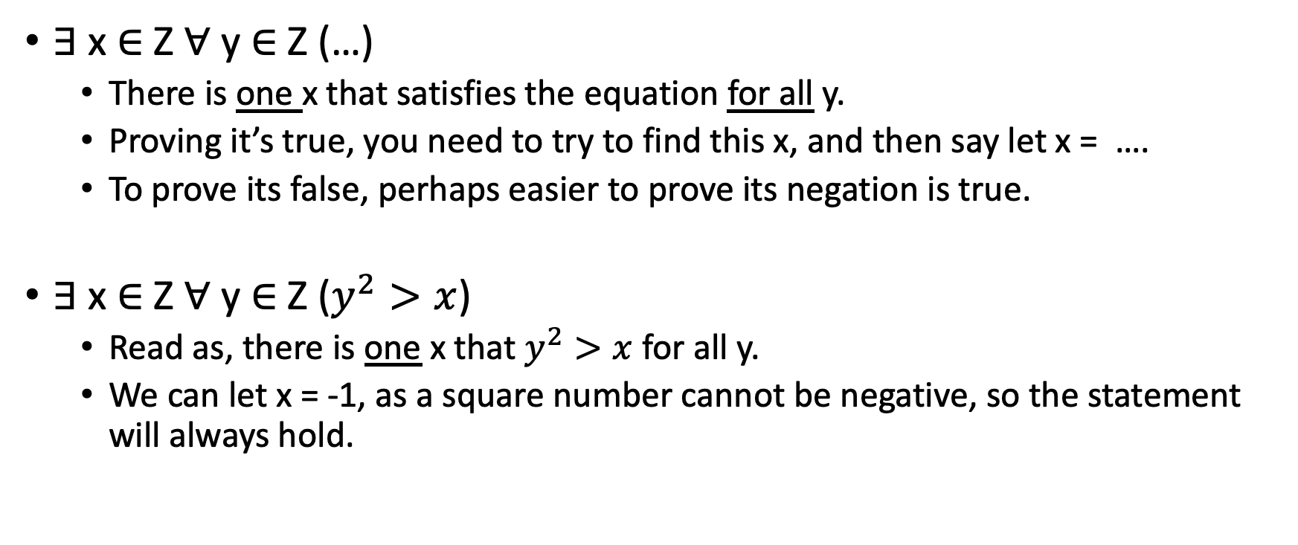
Proving Statements with Quantifiers
∃ x ∈ Z ∀ y ∈ Z (…)
There is one x that satisfies the equation for all y.
Proving it’s true, you need to try to find this x, and then say let x = ….
To prove its false, perhaps easier to prove its negation is true.
∃ x ∈ Z ∀ y ∈ Z ($y^{2}>x$)
Read as, there is one x that $y^{2}>x$ for all y.
We can let x = -1, as a square number cannot be negative, so the statement will always hold.

Slide 8
Proving Statements with Quantifiers
∀x∈ Z ∀ y ∈ Z (…)
For any x or y, we choose, the expression is satisfied.
∀x∈ Z ∀ y ∈ Z (x + y = y + x)
If you wanted to disprove a statement like this, you would only need to find one example of x and y where the statement is not true.

Slide 9
Quantifiers – Helpful Sites
https://math.berkeley.edu/~ehallman/summer-2015/problemSheet2-2-sols.pdf (Just the first page.)
https://www.youtube.com/watch?v=FQ2B5rzBSoM

Slide 10
Subtraction/Union/Intersection of Sets
Let A = {a, d}, B = {a, b}
∪ - Union, All elements in either A or B
A ∪ B = {a, d, b}
∩ - Intersection, Elements in both A and B
A ∩ B = {a}
/ - Difference A/B represents the set of elements that are in A that are not in B
A \ B = {d}
B \ A = {b}

Slide 11
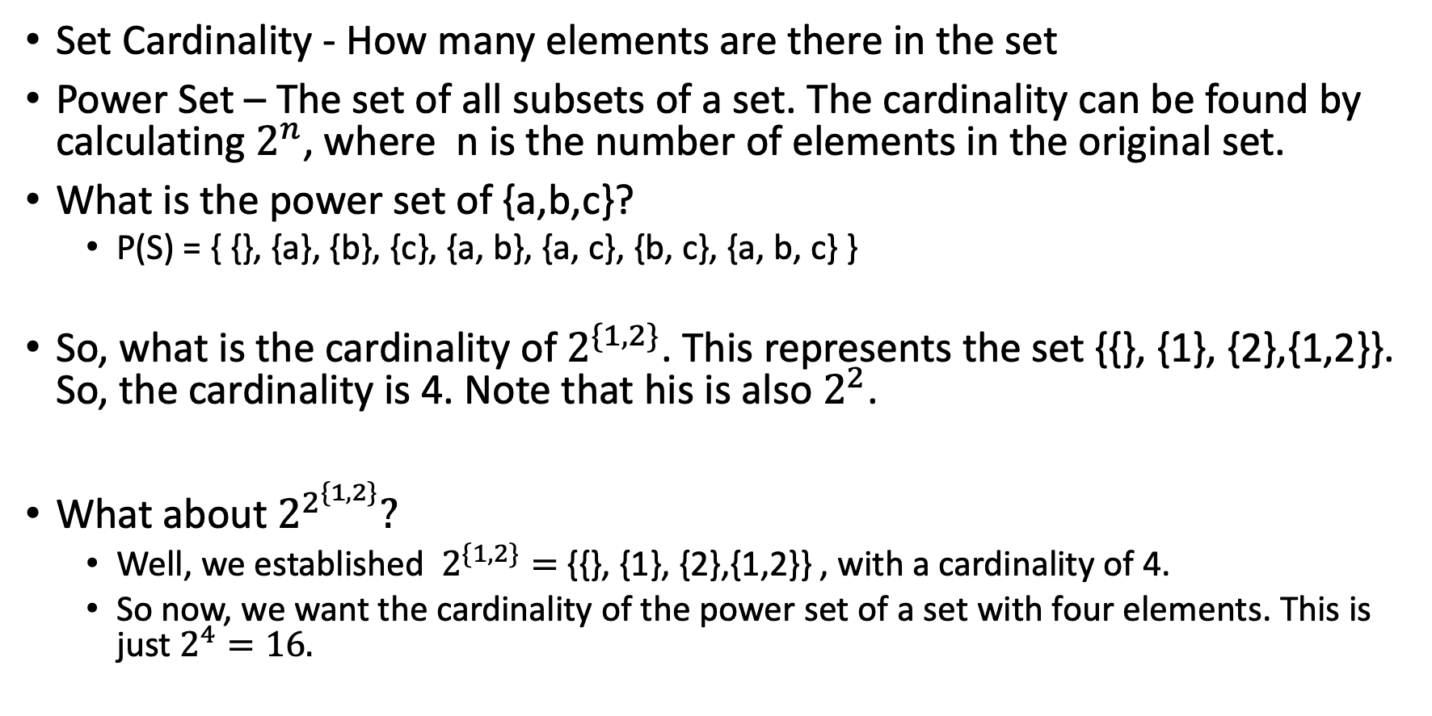
Set Cardinality & Power Sets
Set Cardinality - How many elements are there in the set
Power Set – The set of all subsets of a set. The cardinality can be found by calculating $2^{n}$, where n is the number of elements in the original set.
What is the power set of {a,b,c}?
P(S) = { {}, {a}, {b}, {c}, {a, b}, {a, c}, {b, c}, {a, b, c} }
So, what is the cardinality of $2^{\{1,2\}}$. This represents the set {{}, {1}, {2},{1,2}}. So, the cardinality is 4. Note that his is also $2^{2}$.
What about $2^{2^{\{1,2\}}}?$
Well, we established $2^{\{1,2\}}=${{}, {1}, {2},{1,2}} , with a cardinality of 4.
So now, we want the cardinality of the power set of a set with four elements. This is just $2^{4}=16.$

Slide 12
Problem Sheet 1
For the rest of this session, you can work on your problem sheet.
We’re here to help with the theory, but of course can’t help with the actual questions on your coursework themselves.
Talking about the theory with each other is perfectly fine, but do not discuss your answers for the coursework.

